Slide 1
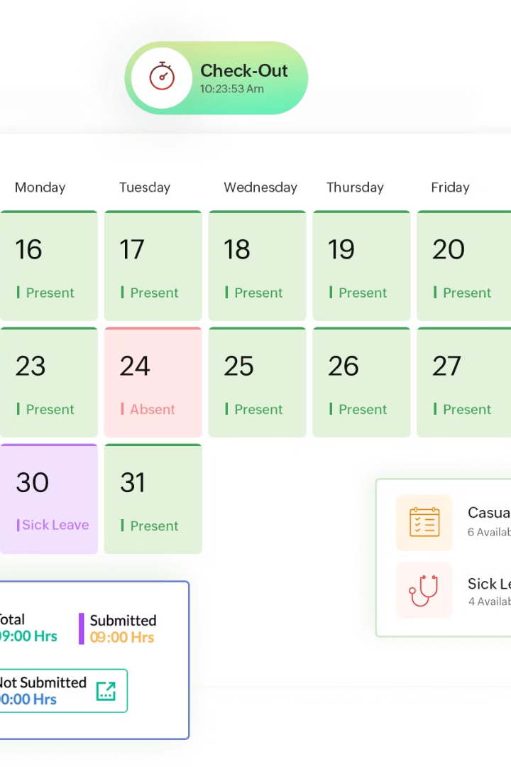
Revolutionizing Workforce Management: Employee Attendance Tracking System(EATS)
Effective attendance tracking boosts productivity, accountability, and workforce management. It optimizes operations, empowering organizations for greater competitiveness.
By Team 1000101

Slide 2
Introduction To Team Members
Rudra Pratap Singh
(Team Leader)
Kartik Agrawal
Pranav Abhimanyu
Nikhil Yadav
HTML
CSS
JavaScript
NodeJS
Express JS
Python
HTML
CSS
JavaScript
Figma
Bootstrap
HTML
CSS
JavaScript
Node JS
HTML
CSS
Kotlin
Dart(Flutter)
Fire Base

Slide 3

Manual Attendance Tracking Challenges
1
Inaccurate Data
2
Inefficient Processes
3
Lack of Transparency
Manual processes can lead to errors, causing attendance and payroll differences.
Manual attendance tracking is inefficient and delays decision-making and resource allocation.
Manual systems lack visibility into attendance patterns, affecting productivity issue.

Slide 4
Introducing the Employee Attendance Tracking System
Digital Monitoring
Real-Time Insights
Alert System
Implement a comprehensive attendance system leveraging
Employee ID, mobile apps, for precise and effortless tracking of employee attendance.
Access detailed attendance reports instantly for informed decision-making and proactive workforce management.
Instantly notifies employees and supervisors of attendance updates or alerts via SMS/WhatsApp.

Slide 5
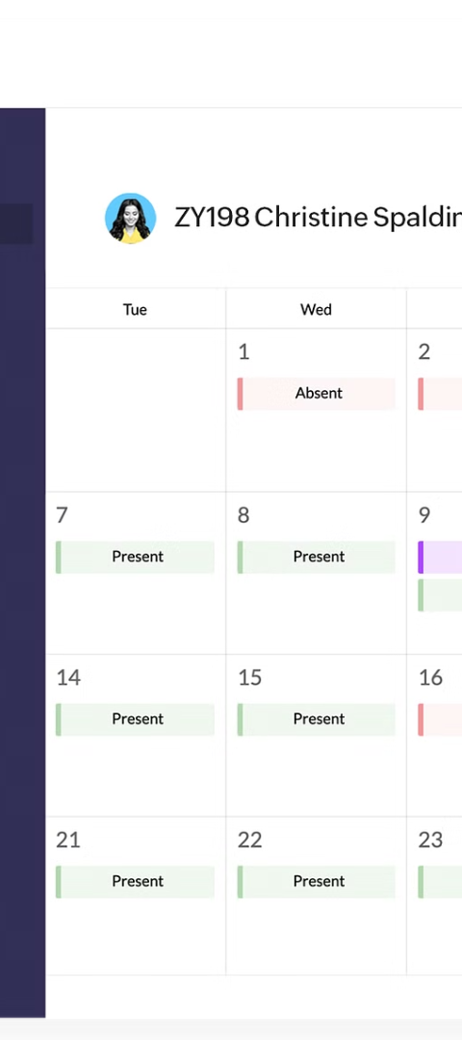
Key Features of the System
1
User-Friendly Interface
User-friendly dashboard with easy-to-navigate tools for attendance management, tracking, and manage schedules.
2
Task Management
Efficient Task Assignment and Management Streamlines Productivity in the Digital Age
3
Data-Driven Decision
Generate detailed attendance reports, analyze trends, and identify areas for improvement.

Slide 6

Tools To Be Used For EATS
HTML
CSS
JavaScript
NodeJS
Express JS
SQL
Dart ( Flutter )
Google Firebase

Slide 7
Scalable and Customizable Solution
Scalability
Customization
Accommodate growing and evolving workforce needs with a highly scalable platform.
Tailor the system to match your organization's unique attendance policies and requirements.

